Slide 1

Data Analysis Project
FROM REELS TO RESULTS: A SRATEGY FOR VIDEO RENTAL SUCCESS
Presented by Yasemin Mustafa
11th May 2025
RS
Rockbuster Stealth

Slide 2
Contents
Data Analysis
Tableau
Link
Introduction
Resources
Summary
Recommendations

Slide 3
Overview
Rockbuster Stealth LLC is a global movie rental company shifting from physical stores to an online service using existing movie licenses to stay competitive.
599 active customers.
Operations span 109 countries worldwide.
Data analysed is from the year 2006.
1,000 film titles across 20 genres
RS
Rockbuster Stealth

Slide 4






Rockbuster Rewinds... to Fast-Forward!
What Happened to Rockbuster Stealth?
Once a global chain of physical movie rental stores, Rockbuster Stealth was a household name.
Why the Panic?
Streaming giants like Netflix and Amazon Prime disrupted the traditional rental model.
What’s the Plot Twist?
Rockbuster Stealth is making a bold move: launching a new online video rental service.
The Mission?
Analyse 2006 sales data using SQL to identify the most promising movie genres and regions, uncovering actionable insights to inform a successful launch strategy.
RS
Rockbuster Stealth

Slide 5
Resources
PostgreSQL for Data Storage
SQL querying
SQL for Data Analysis
ERD and Data Dictionary
Tableau Visualisations
RS
Rockbuster Stealth

Slide 6
Key Questions Driving the Rockbuster Strategy
🎬 What Are the Most/Least Popular Movies?
📊 Statistically, What Do Our Movies Look Like?
🌍 Where in the World Are Our Customers?
🗺️ Does Geography Impact Customer Sales?
💸 Who Are Our Most Valuable Patrons?
RS
Rockbuster Stealth

Slide 7
Which Are the Most/Least Popular Movies?
Only 3% of revenue in 2006 comes from the top 10 titles — revenue is broadly distributed, not blockbuster-led.
Top vs. bottom earners reveal clear value drivers and underperformers in 2006.
RS
Rockbuster Stealth

Slide 8
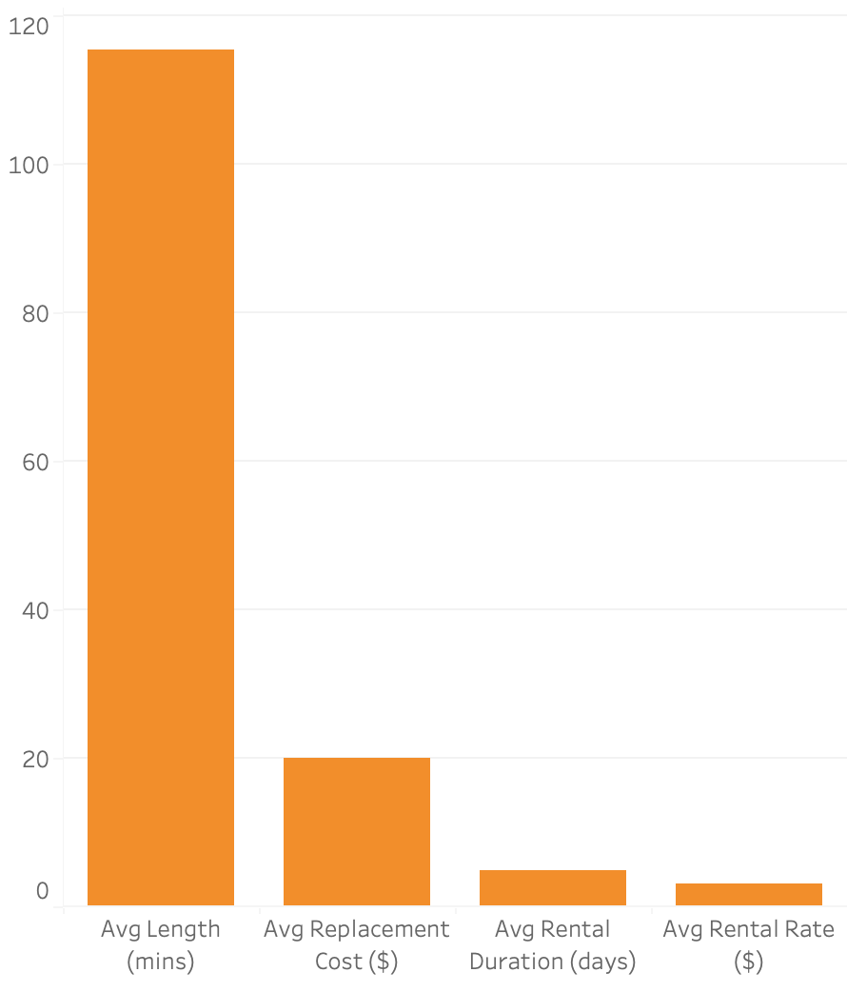
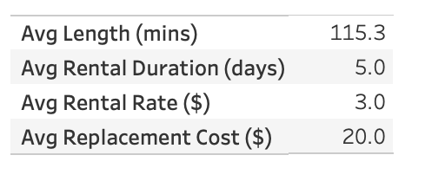
Statistically, What Do Our Movies Look Like?
With most rentals lasting 5 days, rental rates averaging $3, and a $20 replacement cost, there’s room to explore pricing tiers and loss-prevention strategies.
RS
Rockbuster Stealth
8

Slide 9
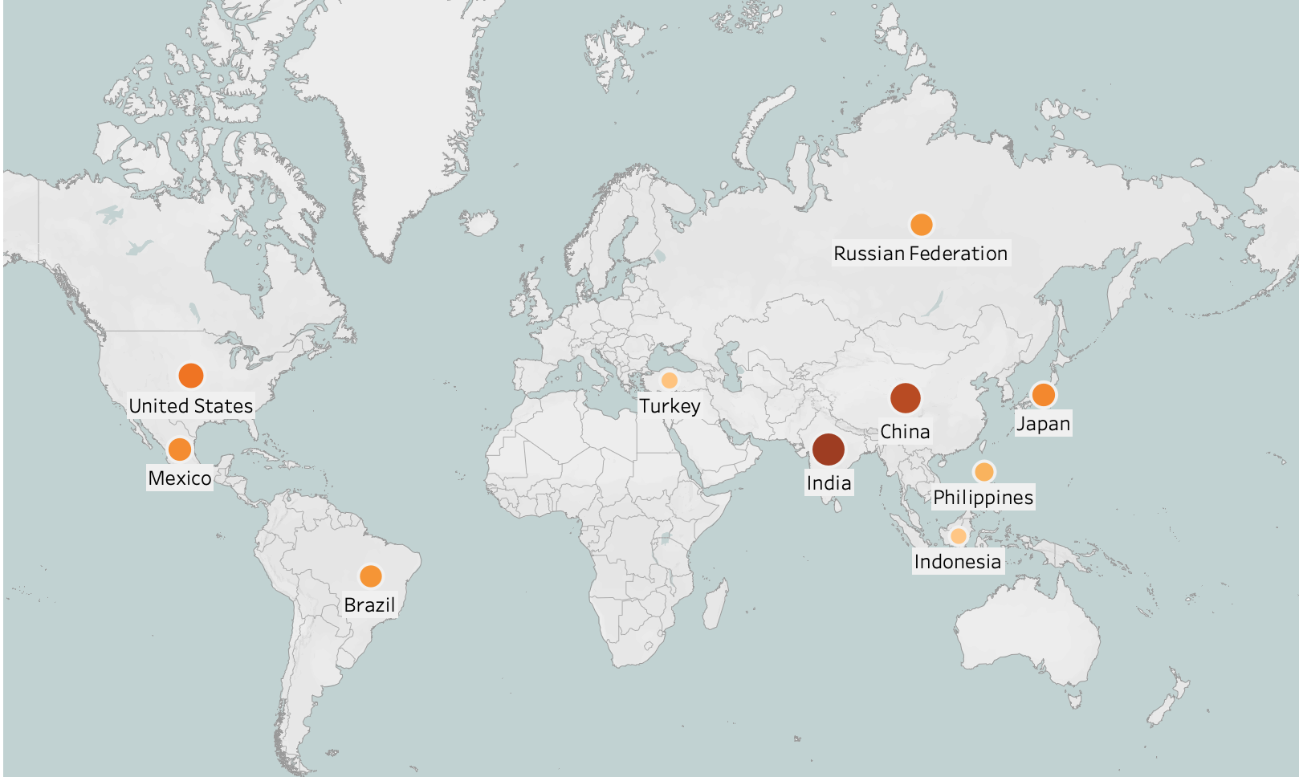
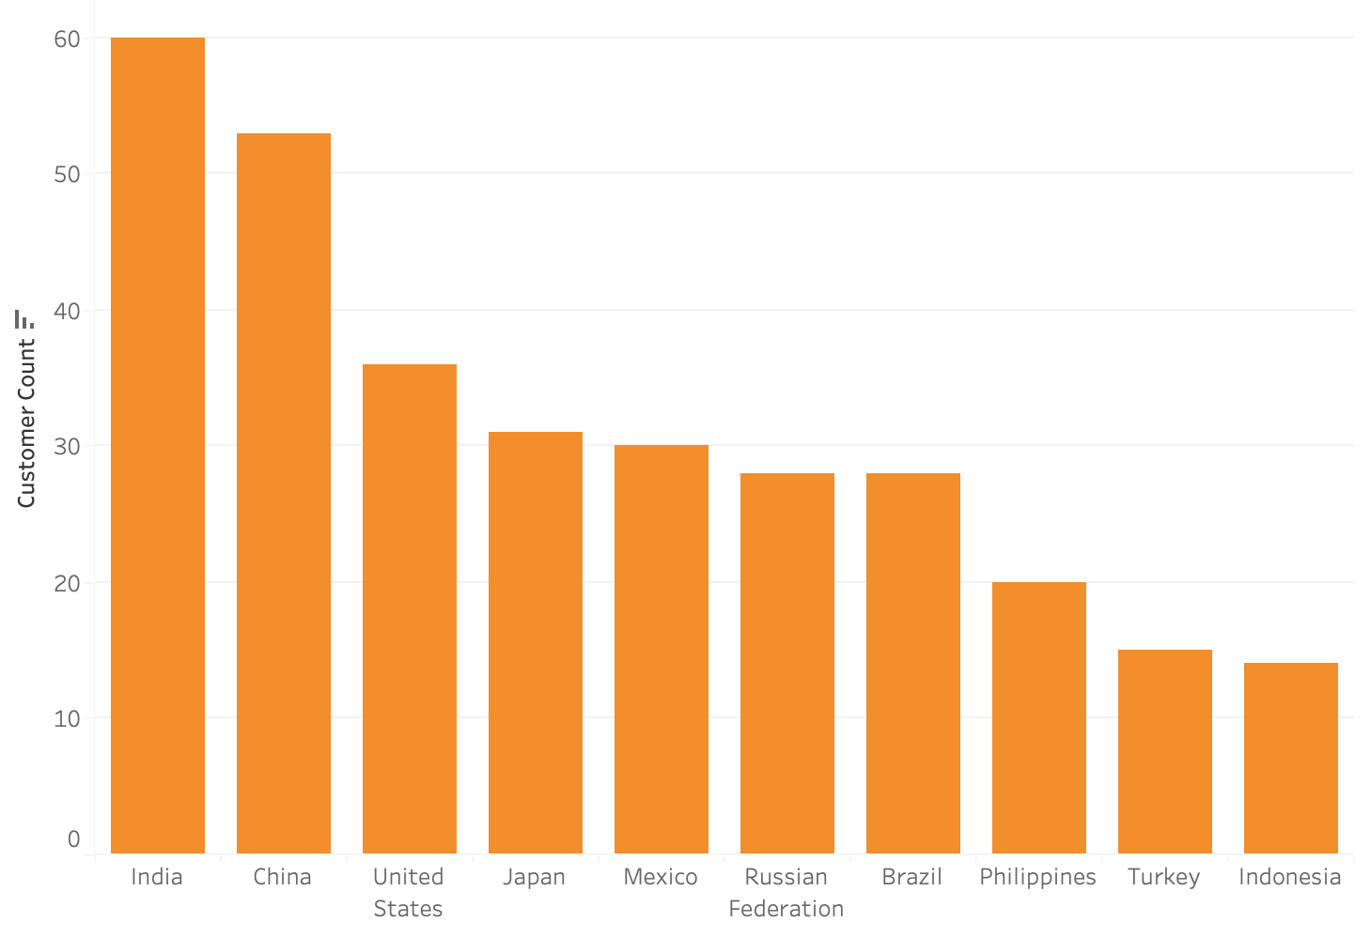
Where in the World Are Our Customers?
Rockbuster Stealth operates globally, but revenue is concentrated among just 10 key markets, namely India, China, and the United States.
RS
Rockbuster Stealth

Slide 10
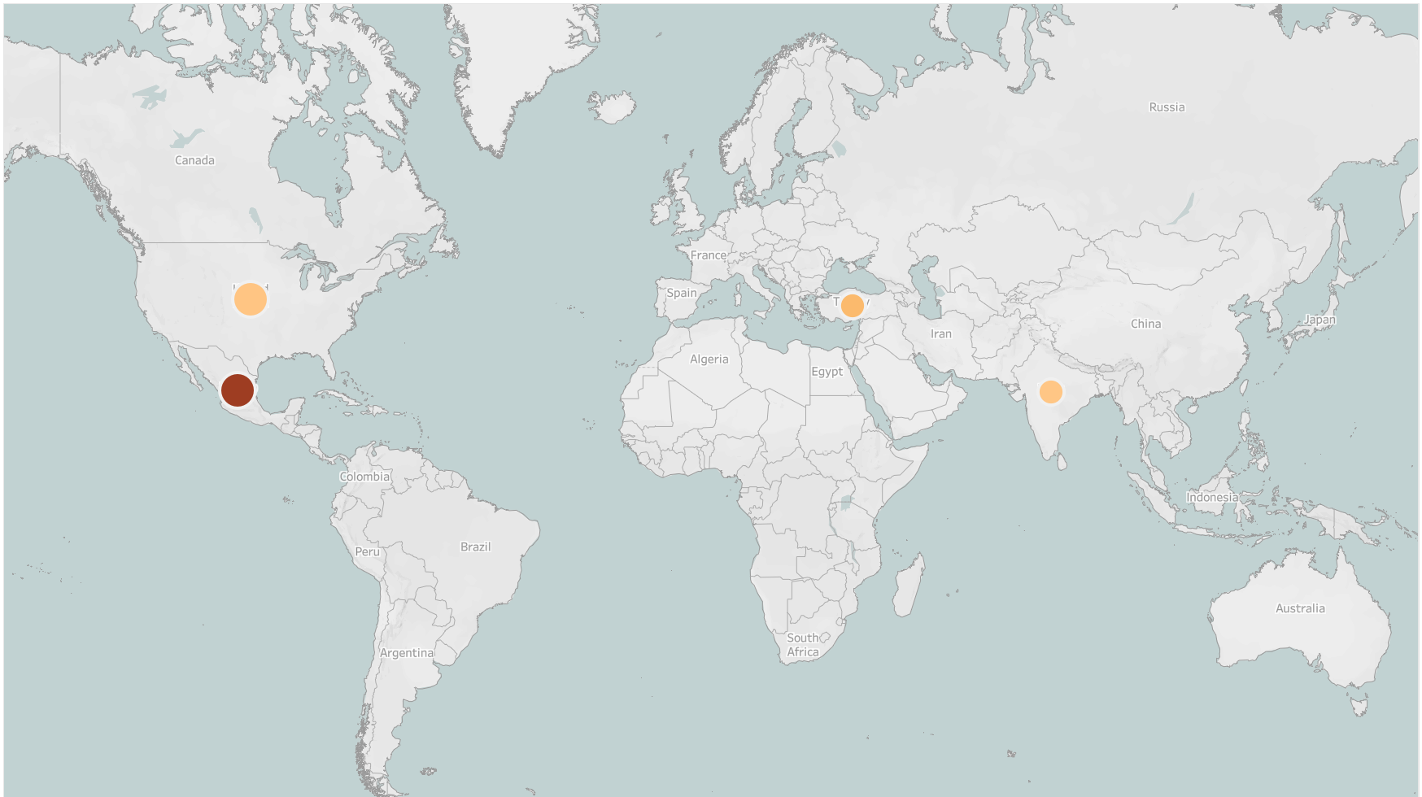
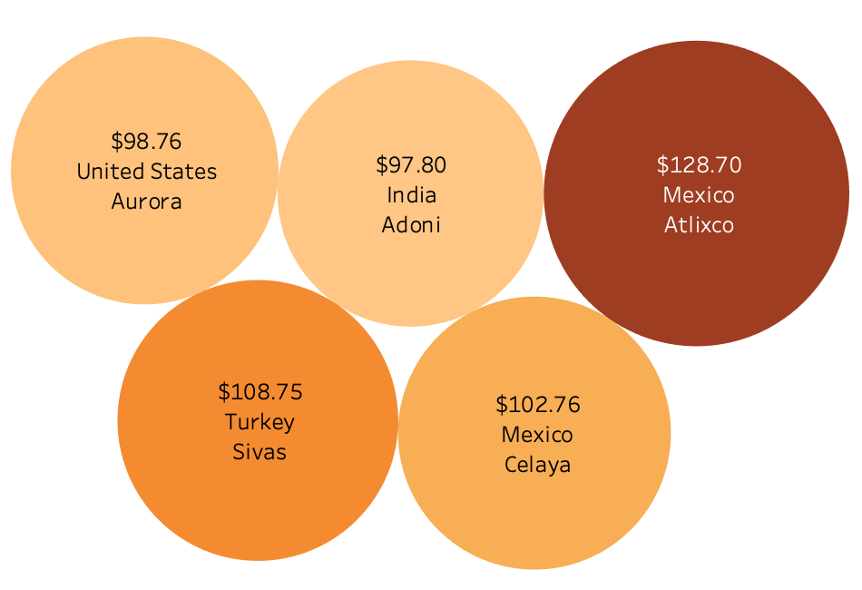
Where Do Customers Have the Highest Average Sales Number?
Rockbuster’s top five revenue-generating customers are concentrated in cities across Mexico, Turkey, the U.S., and India .
RS
Rockbuster Stealth

Slide 11
Who Are Our Most Valuable Patrons?
Customer ID | First Name | Last Name | Countries | Cities | Total Amount Paid ($)
84 | Sara | Perry | Mexico | Atlixco | 128.70
518 | Gabriel | Harder | Turkey | Sivas | 108.75
587 | Sergio | Stanfield | Mexico | Celaya | 102.76
537 | Clinton | Buford | United States | Aurora | 98.76
367 | Adam | Gooch | India | Adoni | 97.80
Among the top five cities, these five highly active customers highlight strong engagement.
RS
Rockbuster Stealth

Slide 12
Summary
🎬 Revenue is evenly distributed across a wide range of movie titles — not driven by blockbusters alone.
📊 Typical rentals last 5 days at $3, with a $20 replacement cost — suggesting potential for tiered pricing and improved loss prevention.
🌍 Top customer bases include India, China, the U.S., Japan, and Mexico — revealing key markets for engagement.
💸 Loyal customers are concentrated in North America and Asia, offering clear targets for retention strategies.
🗺️ Focusing the online platform on high-performing regions could maximise growth and profitability.
RS
Rockbuster Stealth

Slide 13

Recommendations
Launch
Strategy
Prioritise top 10 countries and cities for a phased online rollout to maximise early adoption and reach.
Customer Targeting
Focus marketing on high-value segments to drive retention and increase lifetime vale.
Top-performing movies should guide licensing decisions to boost revenue and cut costs.
With most rentals lasting 5 days and rates averaging $3, explore tiered pricing or loyalty incentives for longer rentals.
Benchmark pricing against streaming competitors to ensure market competitiveness.
Content & Pricing
Ongoing Monitoring
Implement SQL-driven reporting to regularly track performance and guide data-led decisions.
RS
Rockbuster Stealth

Slide 14

Questions
Let’s discuss how data can drive Rockbuster Stealth’s comeback strategy
RS
Rockbuster Stealth

Slide 15
THANK YOU
for your attention
RS
Rockbuster Stealth

